Slide 1
Segmentation at Sticks Kebob Shop
Emanuel Fuller
Stephen C Washington III
Felicia J Draper
Jewell Anderson
David Fleischman
Group 4 MaR 653

Slide 2
CHOOSING FAST FOOD
Consumer Choices: Dining at a fast food restaurant based on various factors such as convenience, value, taste, menu/variety, health, and community.
Different Segments Value Different Choices: A busy soccer mom may be more concerned with health & convenience, while a white collar lunch crowd craves nutritional satisfaction along with convenience & value. Both are Kebob customers. Location and value would be important to both these groups.
Taste Matters: The taste of the food is among the most significant factors in choosing a QSR. Simply put, if you like Kebobs, taste is one of the main reasons you would visit the establishment.
Variety Overwhelms: Too many choices turn off the consumer. Both In-N-Out and Shake Shack with limited menus, overwhelmingly prove this theory. Variety matters, but among the customers and non its one of the qualities that is least valued when choosing to eat out.

Slide 3
THE STICKS CUSTOMER
The Average STICKS Customer:
- has family (defined by household type)
Earns between $50 – 100K
Uses coupons twice a month.
The Customer Motivation:
Value
Taste
Healthiness of a meal
Loyalty to Community.
The Non-STICKS Customer
Bring lunch to work
Lower Income
Less concerned with nutritional value.
This is significant, because STICKS business depends on a more health conscious the lunch crowd.
Preferred QSR: The sticks customers are primarily going to places such as Panera which are more expensive with healthier food options more readily available.
Favorite Fast Food Chains: Non-sticks customers frequent McDonald’s and Hardee’s. These are primarily cheaper with less health-conscious choices readily available.

Slide 4
CUSTOMER SEGMENTS
Our elbow plot curves between 3 and 4, therefore we chose 3 segments, basing it on mainly on 4 questions
1 – What is your age? 2 – How would you describe your HH type? 3 – What is your approx. household income? 4 – Please indicate how important the following factor are when you visit a restaurant
Segment 1: This is the youngest of our segments, with a mid level income and smallest HH type. Community is very important. Taste is among the most important factors in choosing a QSR.
Segment 2: The age range is slightly older than #1, however their income is the smallest of segments. Many of the attributes within this group show apathy toward choices: convenience, taste, ambiance, menu variety. This group seems most challenging to market to. What do they like?
Segment 3: These are our biggest earners with the biggest household. They put a lot of focus on value and health conscious options in their choices. Convenience is not as important as an important a factor as community.
We Recommend Targeting Segment #1. Based on the survey, it is very likely they are recent college grads (small HH, mid income, young) and established locals who have the similar values to Sticks overall goal of Community.

Slide 5
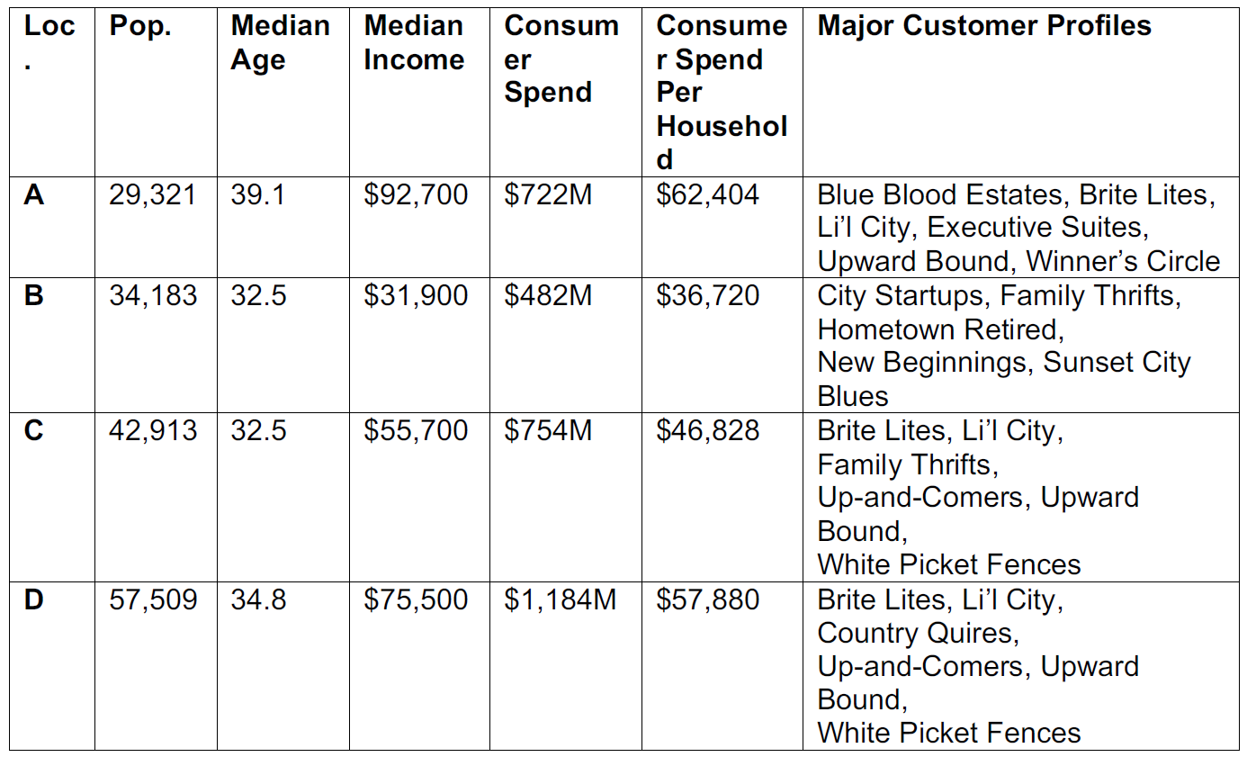
WHERE TO NEXT?
Assuming we were to open up a NEW STICKS, our data shows that Segment 1 is our desired grouping.
Segment A income is a bit on the high side for Sticks
Segment B income is too low to target for Sticks
Segment C could be a possibility
Segment D seems to be the winner. It is the most similar to Segment 1 in terms of HH and income and would fit the mold of the group that’s visited Sticks the most. It’s the largest population, has high consumer spend, and is a mix of young professionals and established locals.
Also, the major customer profile difference between C and D is that C are Family Thrifts as opposed to Country Quires. Our research proves that our customers use coupons (Thrifts), which could open up potential for another market down the line. The spending power of location D grouped with how often they visited Sticks in the last 6 months (19) in comparison to Sticks current customer base is to close to ignore.

